Slide 1
Color Detection -Using Python and Open CV

Slide 2
Objective:
The objective of a color code detection project using OpenCV is to develop a computer vision system that can accurately detect and recognize color codes or color markers in images or videos, and potentially decode them for further processing or interaction.
This can be applied in various domains, such as color-based sorting, object identification, human-computer interaction, image processing, or for educational purposes. The project aims to implement image processing techniques, utilize OpenCV's functionalities, and potentially other machine learning or computer vision algorithms to achieve accurate and efficient color code detection, with the ultimate goal of meeting the specific requirements and objectives of the project's application or use case.

Slide 3
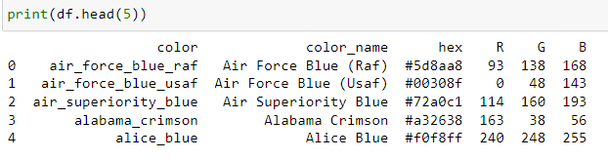
Understanding the Data:
The csv file contains set of colour names and their respective colour codes and RGB components
Each pixel in the image consists of 3 colour components
-R= Red colour component
-G = Green components
- B = Blue components
In OpenCV it is in the BGR format

Slide 4
What is OpenCV:
OpenCV (Open Source Computer Vision Library) is an open-source computer vision and machine learning library that provides tools and functions for image and video processing, as well as computer vision tasks such as object detection, face recognition, and camera calibration. It is written in C++ and Python, and is widely used in applications like robotics, autonomous vehicles, medical imaging, and more. cv2, also known as "OpenCV-Python," is the Python wrapper for OpenCV, providing a Pythonic interface to utilize OpenCV's functionality in Python code. cv2 enables developers to leverage the power of OpenCV in Python, a popular programming language for machine learning and computer vision, for various image and video processing tasks.

Slide 5
Steps :
Step 1 = Importing libraries required for the project
Step 2 = -Reading csv file and image in which we want to detect the colour code of the pixels
Step 3 = Since our data in csv file does not have index so creating index of colour, colour name, hex, R, G, B
Step 4 = Reading image using open cv and resizing the image
Step 5 = calculating minimum distance from all colors and get the most matching color
- The provided code defines a function named get_color_name that takes three arguments, R, G, and B, which represent the Red, Green, and Blue color channels, respectively, of a given pixel in an image. The function calculates the minimum distance between the input RGB values and a list of colors stored in a DataFrame (df) to determine the most matching color.

Slide 6
Steps :
- If the calculated d is less than or equal to the current minimum value stored in the variable minimum, the minimum value and the corresponding color name from the DataFrame (df) are updated in the variables minimum and name, respectively.
Step 6 = function to get x,y coordinates of mouse double click
The provided code defines a function named draw_function that is intended to be used as a callback function for handling mouse events in OpenCV. The function takes five arguments: event, x, y, flags, and params, which represent the type of mouse event, the x and y coordinates of the mouse cursor, any flags associated with the event, and any additional parameters that may be passed.
Inside the function, there is a conditional statement that checks if the mouse event is a left button double-click event (cv2.EVENT_LBUTTONDBLCLK). If this condition is met, the code inside the conditional block is executed.

Slide 7
Steps :
Step 7 =Creating window
-cv2.namedWindow() function. This function is used to create a window that can display images.
- cv2.setMouseCallback() This function sets the mouse event handler for the window, which means that the draw_function will be called automatically by OpenCV whenever a mouse event occurs within the window.
Step 8 = -Creating Rectangle and string on image to display the pixel information

Slide 8
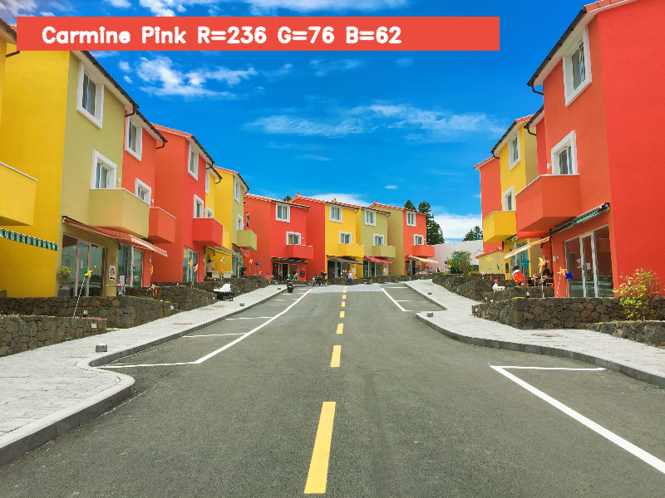
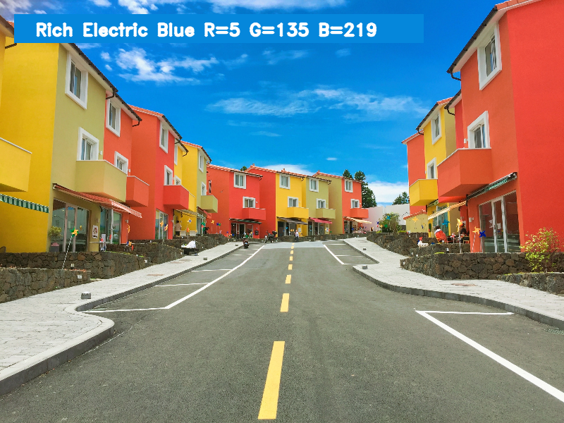
Output from the model :

